Slide 1
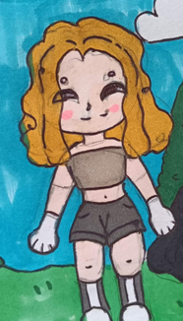
I am Julia and this is My ways to save our earth.

Slide 2
The less water you use, the less runoff and wastewater that eventually end up in the ocean.

Slide 3
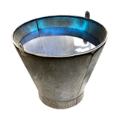
Cut down on what you throw away.
Store food waste in a compost bin.
composter

Slide 4
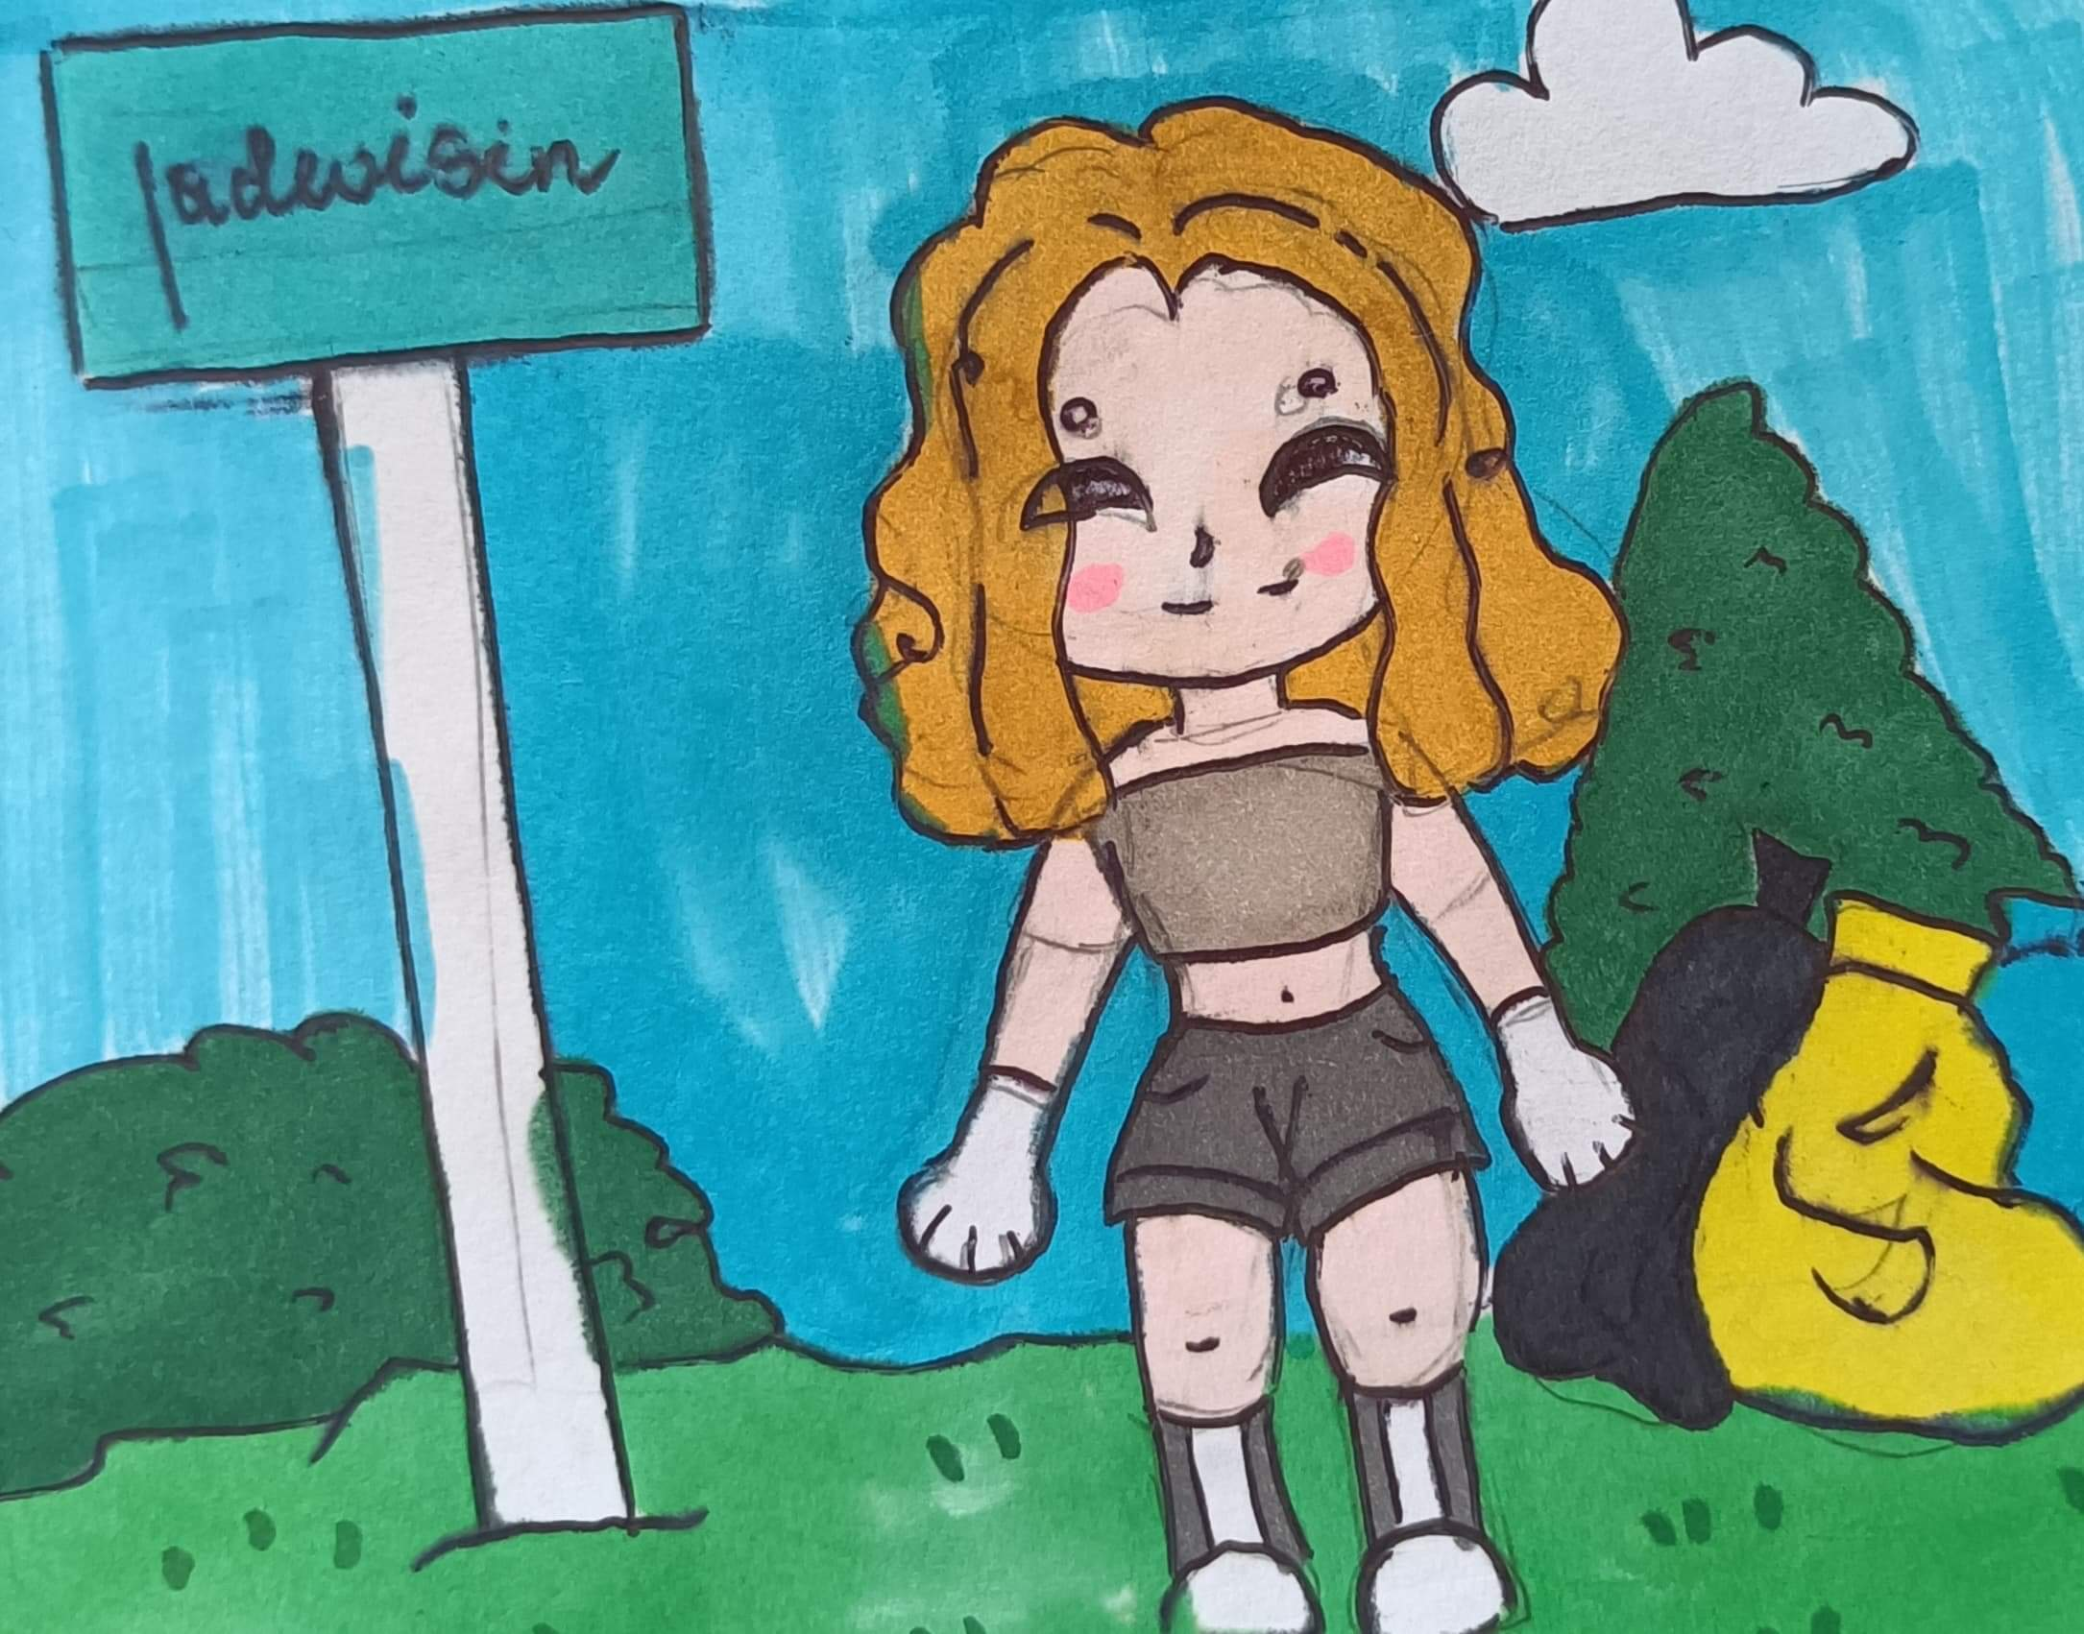
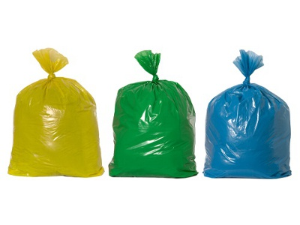
Volunteer for cleanups in your community. You can get involved in protecting your watershed, too.

Slide 5
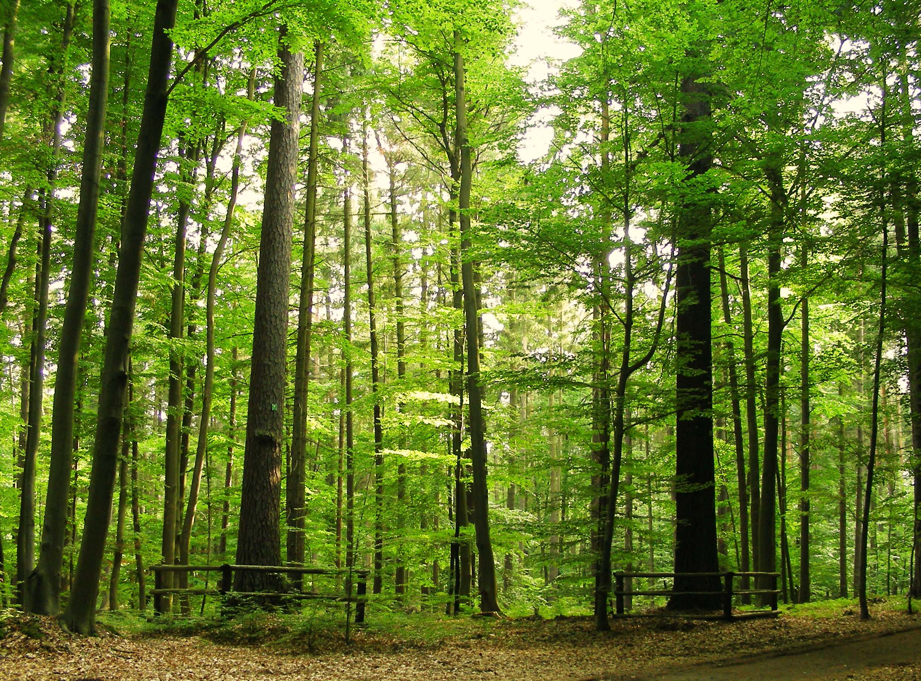
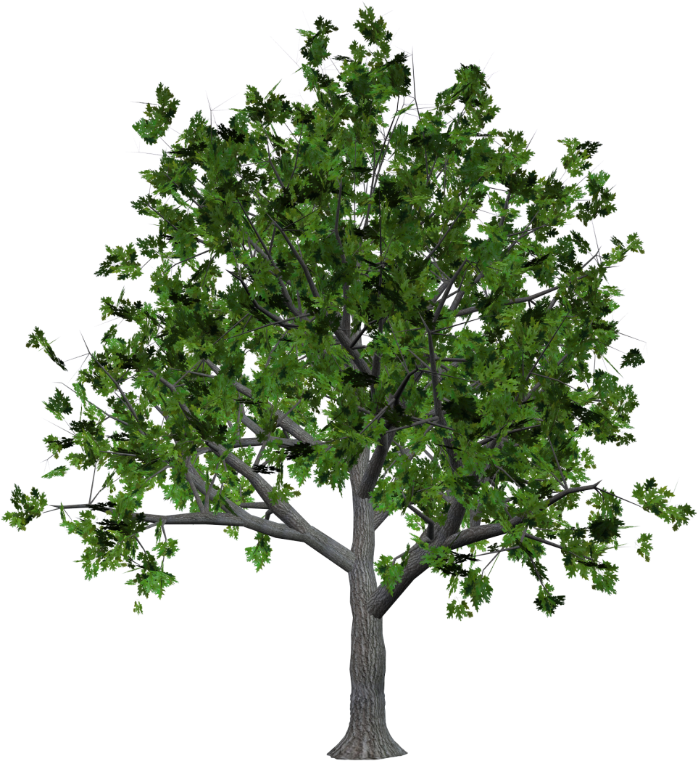
Plant a tree !

Slide 6
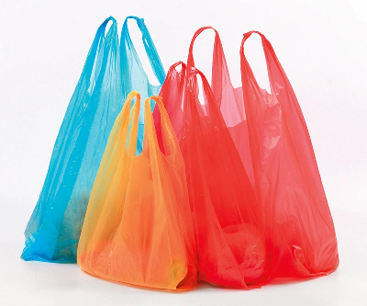
Buy less plastic and bring a reusable shopping bag.

Slide 7
Energy efficient light bulbs reduce greenhouse gas emissions. Also flip the light switch off when you leave the room!

Slide 8
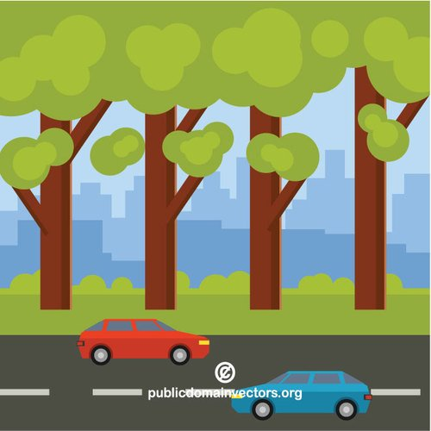
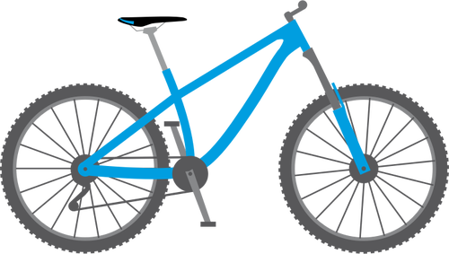
Bike more, drive less!

Slide 9
Thank you Julia Korbuszewska ☺

